Slide 1
NGINX
A Powerful Web Server, Reverse Proxy, and Load Balancer

Slide 2
Agenda
What is NGINX ?
Roles of NGINX
Working of NGINX
6WH Model
Live Demo
Benefits
Q&A

Slide 3
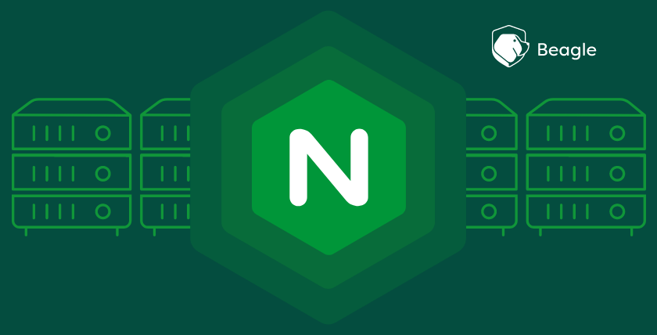
What is NGINX?
NGINX (pronounced "engine-X") is a versatile open-source software primarily used as a high-performance web server, reverse proxy, load balancer, and HTTP cache.
It's known for its efficiency, scalability, and ability to handle numerous concurrent connections.

Slide 4
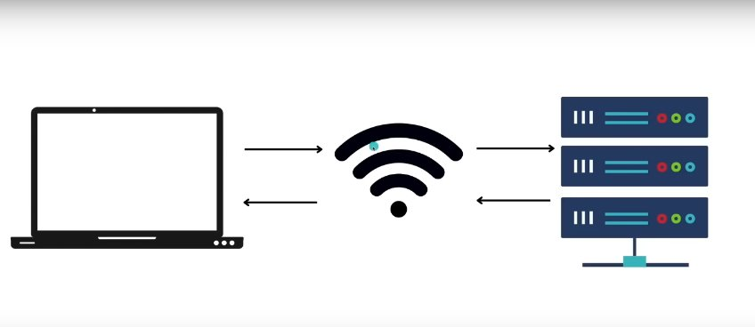
Working of NGINX
Without NGINX

Slide 5
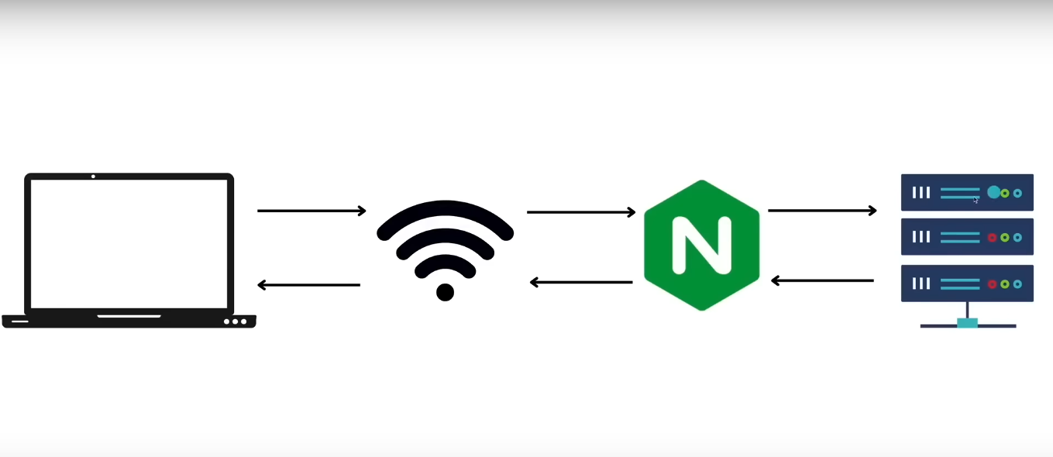
With NGINX

Slide 6
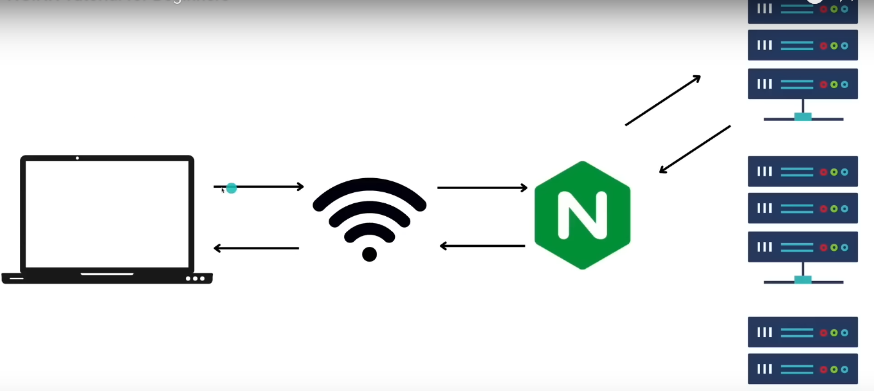
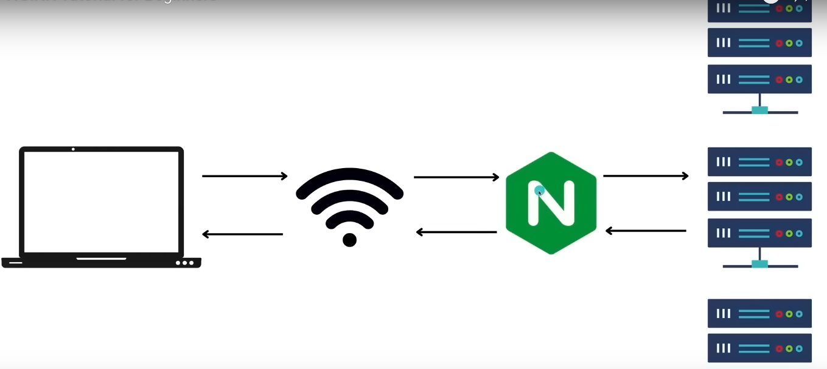
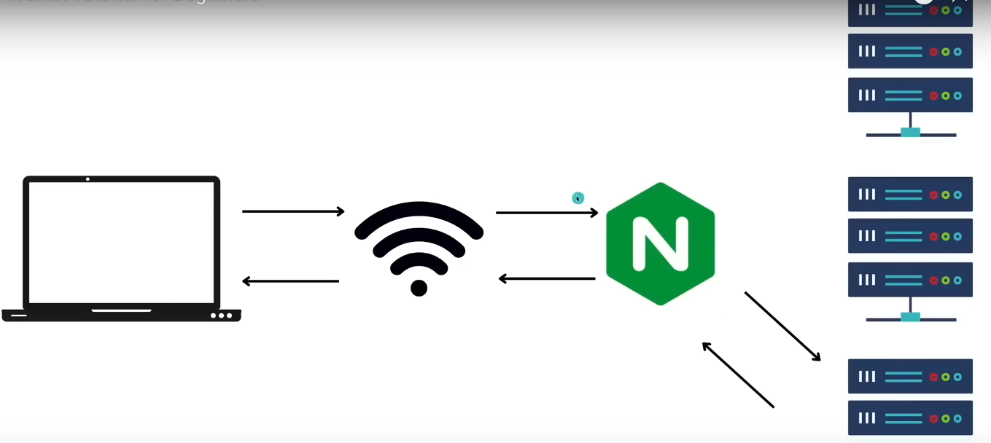
Round-Robin-Algorithm
1
2
3

Slide 7
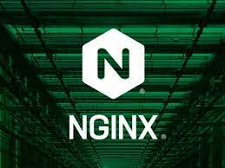
Roles of NGINX
High-performance HTTP server
Reverse proxy server, API Gateway
Load balancer
Email (IMAP/POP3) proxy

Slide 8

Why NGINX?
Reverse Proxy & Load Balancing: Distribute traffic across microservices.
Speed & Efficiency: Handles many concurrent connections using an event-driven model.
Security: SSL/TLS termination, rate limiting.
Popular: Used by Netflix, Dropbox, WordPress, etc.
Caching: Reduces backend load, improves latency.

Slide 9



What If NGINX Is Not Available?
Increased latency and downtime.
No centralized proxy, higher traffic load on app servers.
Harder SSL/TLS management.
No static file caching.
Backend services exposed directly to clients.

Slide 10
What are the Alternatives?
Feature | NGINX | Apache | HAProxy | Caddy
Web server | yes | yes | no | yes
Reverse Proxy | yes | yes | yes | yes
Load Balancer | yes | yes | yes | yes
SSL Auto | no | no | no | yes
Ease of Config | Medium | Complex | Medium | Easy

Slide 11
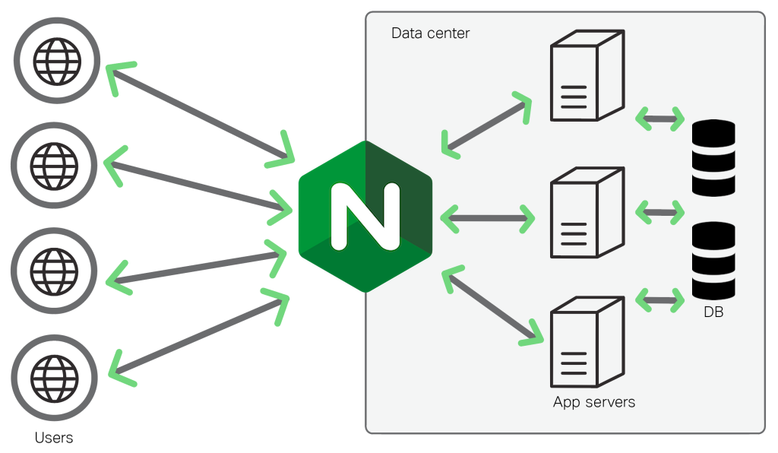
When to Use NGINX?
As a reverse proxy in front of backend microservices (FastAPI, Spring Boot).
To load balance traffic among app instances.
Need to serve static content efficiently.
When implementing SSL termination.
For high availability and scaling.

Slide 12
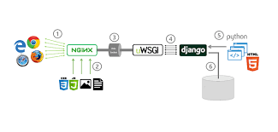
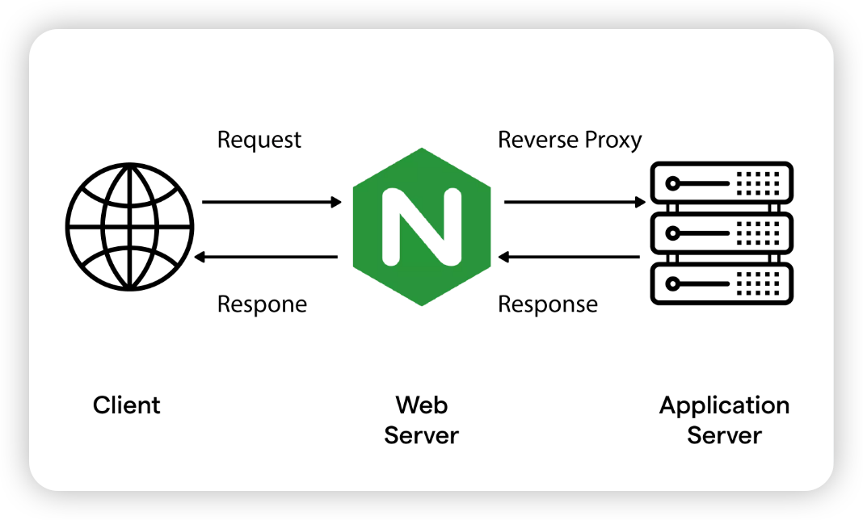
Best Scenarios for NGINX
Microservices architectures (API Gateway + Backend)
SPA frontend + REST backend deployment
Docker/Kubernetes deployments

Slide 13
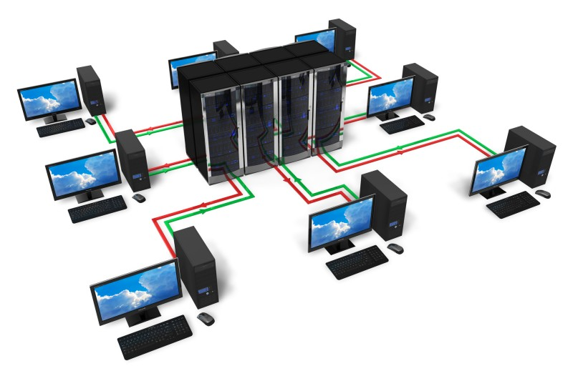
Live Demo
Static content
Mime Types
Location Context
Rewrites & Redirect
Load Balancer
Proxy Server

Slide 14
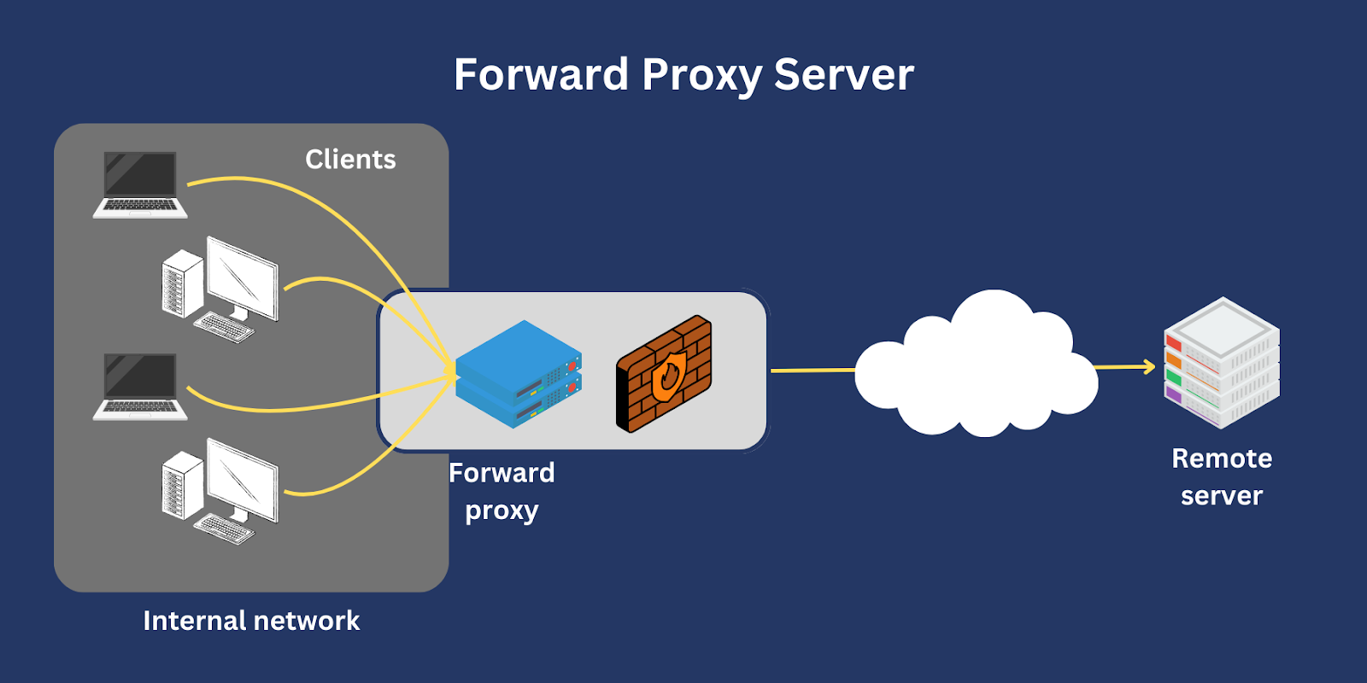
Proxy-Server
Forward Proxy Server
A forward proxy acts as an intermediary between clients and the internet, forwarding client requests to external servers and returning responses. Essentially, it sits in front of clients and handles their internet traffic, often for security, access control, or performance reasons. (eg: using private internet connection in office)

Slide 15
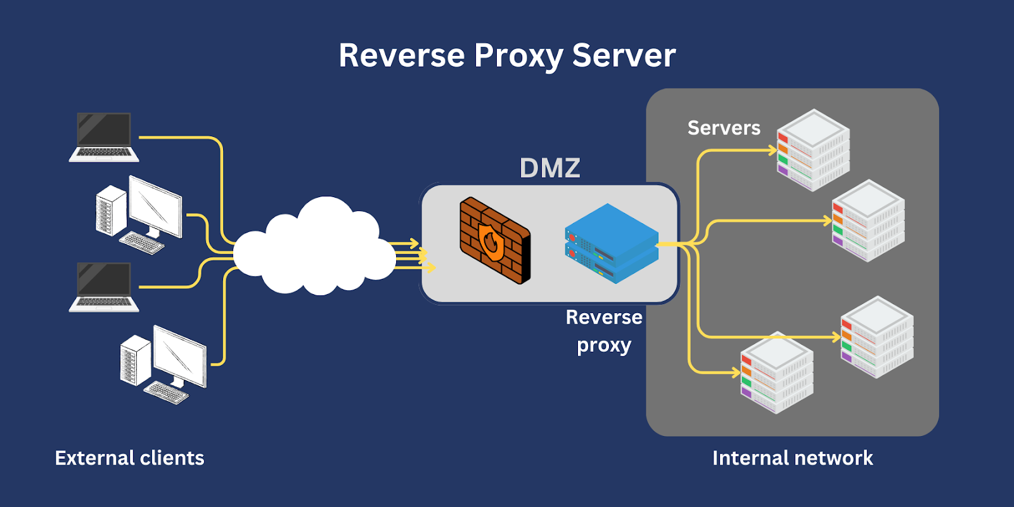
Proxy-Server
Reverse Proxy Server
A reverse proxy server acts as an intermediary, sitting in front of one or more web servers to handle client requests. It receives these requests and forwards them to the appropriate backend server, effectively hiding the server's true address from the client. This setup offers several benefits, including improved security, performance, and reliability for the web application.

Slide 16
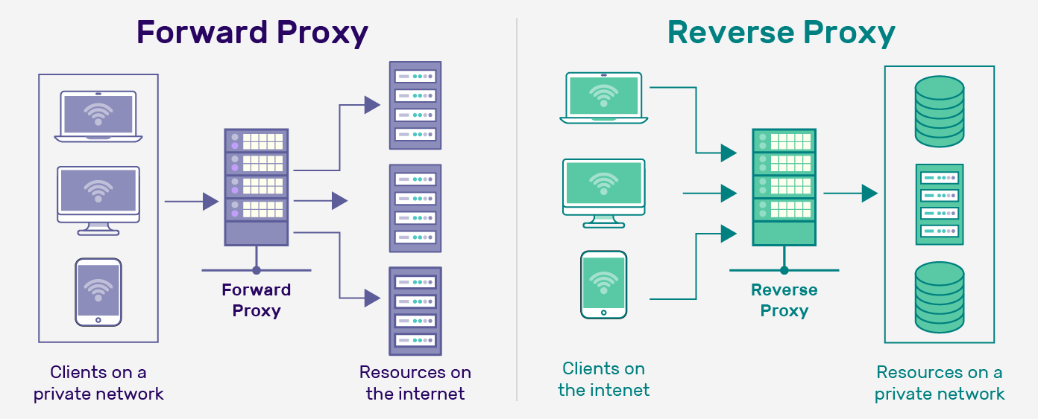
Difference between Forward and Reverse Proxy servers

Slide 17
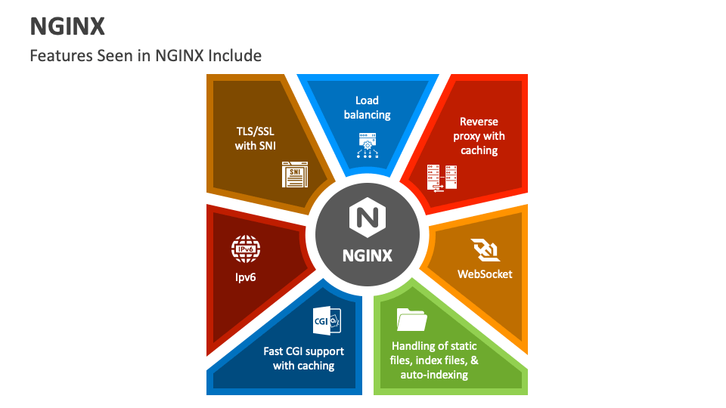
Benefits
High concurrency handling
Simple configuration for complex routing
Flexible reverse proxy
Lightweight and high-performance
Secure and robust

Slide 18

Q & A

Slide 19
Abishek K
Junior - Software Engineer

